Slide 1

Frontend development overview
Programming Applications And Frameworks (It3030)

Slide 2
Learning outcomes
After completing this lecture, you will be able to,
Describe the main concepts associated with frontend web development.
Apply the knowledge gained in developing more robust frontend web applications.
Apply the learned concepts to create more secure web applications.

Slide 3
Contents
What is frontend development?
Why is frontend development important?
HTML, CSS, JS
Document Object Model (DOM)
State in Web apps
State Management
Web Application Security
OWASP Top 10 Security Risks & Vulnerabilities
HTTP Security Headers
Wrap up
Summary

Slide 4
What is Frontend development?
Frontend development is the development of visual and interactive elements of a website that users interact with directly.
Also known as Client-side development.

Slide 5
Why is Frontend development important?
Backend vs. Frontend
Frontend web development focuses on creating a good look and feel for the user.
Backend web development focuses on engineering the web application’s structure, logic and data.

Slide 6
Why is Frontend development important?
Frontend development can be considered under two aspects.
Designing a good look and feel
HCI Design, UI/ UX etc.
Engineering the designed good look and feel
Frontend technologies
E.g., HTML, CSS, JS, Different frameworks, libraries etc.

Slide 7
HTML, CSS, JS
Frontend development is done with a combination of technologies in which,
HTML provides the structure
CSS provides the styling and layout
JavaScript provides the dynamic behavior and interactivity

Slide 8
Document object model (DOM)
What do we actually manipulate with these technologies?
Document Object Model (DOM)!

Slide 9
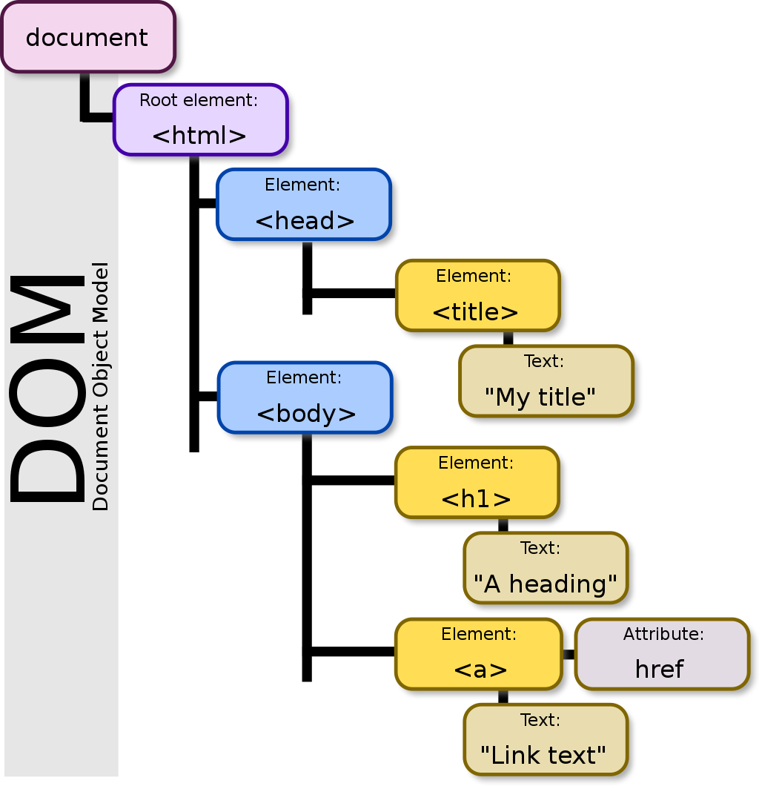
Document object model (DOM)
Source: https://en.wikipedia.org/wiki/Document_Object_Model

Slide 10
Document Object Model (DOM)
Document Object Model (DOM) – An object-oriented representation of the HTML structure
DOM is not a JS functionality.
JS is the mostly used language to manipulate it, but other languages can also be used.
It is just a Web API.
[YouTube] The DOM in 4 minutes

Slide 11
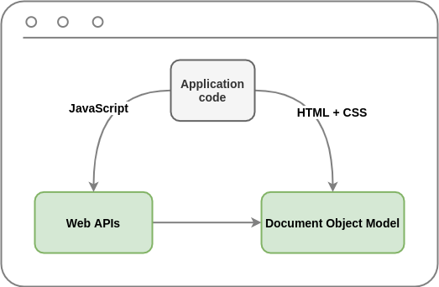
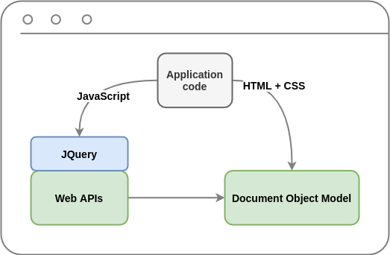
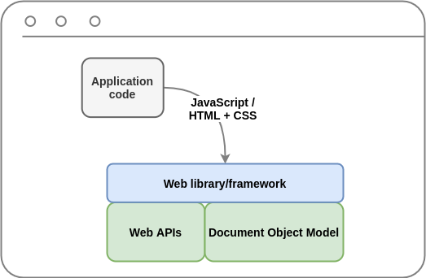
Evolution of Frontend Development
Source: https://www.epineda.net/the-evolution-of-front-end-development/amp/
Notes:
The application code has the option to use "JQuery," which is a fast, small, and feature-rich JavaScript library. It simplifies things like HTML document traversal and manipulation, event handling, and animation.

Slide 12
React JS
Developed and maintained by Facebook and Instagram.
A JavaScript library for creating user interfaces.
Serves as the view of MVC architecture.
Suitable for large web application which use data and change over the time without reloading the entire page.
React Native caters developing mobile application for various platforms and React VR caters developing VR applications.
Aims at Speed, Simplicity and Scalability.

Slide 13
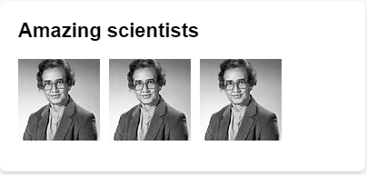
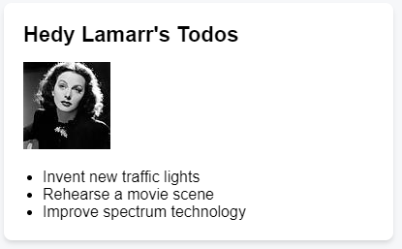
React : Components
Components are one of the core concepts of React.
They are the foundation upon which you build user interfaces (UI)
UI is built from small units like buttons, text, and images.
React lets you combine them into reusable, nestable components.
From web sites to phone apps, everything on the screen can be broken down into components.
https://react.dev/learn/thinking-in-react

Slide 14
Notable features
One-Way data flow.
Single source of truth - Data is originated and kept in one place, data is immutable.
Data flow from the parent component to the child component.
Action flow from child component to parent component.
Virtual DOM
DOM manipulation is cost instead react create a virtual DOM tree and compare it with the rendered tree and update only what is changed.
JSX
React JS language for defining user interfaces.
HTML/XML like syntax.
Prevents cross-site scripting attacks by converting expressions to strings.

Slide 15
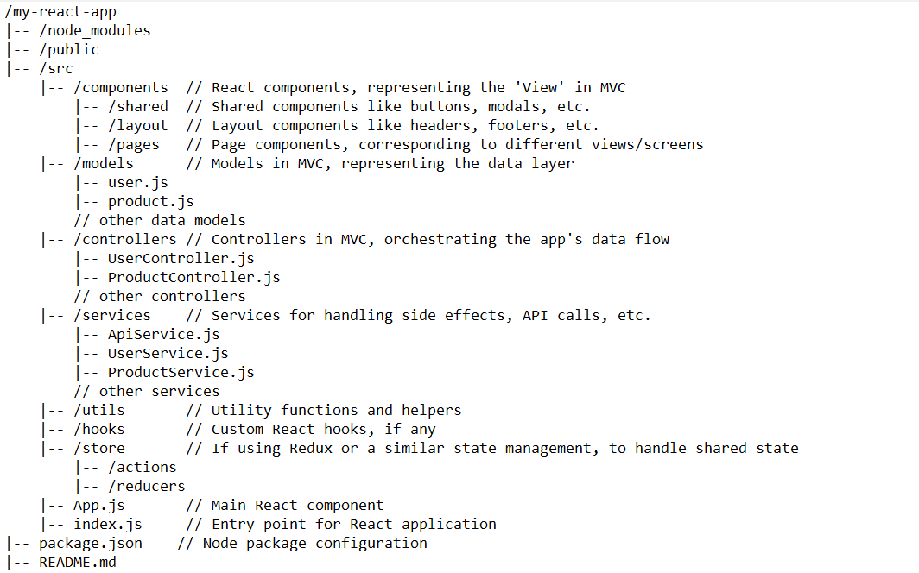
Project Structure

Slide 16
State in Web Apps
State refers to the current condition or data of the application at a given point in time.
State is important in web applications because it affects the behavior and appearance of the application.
[YouTube] What is "State" in Programming?

Slide 17
State management in web apps
State management is a concept in web development that refers to the management and manipulation of data or information within an application.
In simple terms, it involves controlling the data flow and ensuring that the application's data is consistent and up-to-date.

Slide 18
State management in web apps
Proper management of state is important for the performance and reliability of web applications.
Poorly managed state can result in slow application performance, data inconsistencies, or security vulnerabilities.

Slide 19
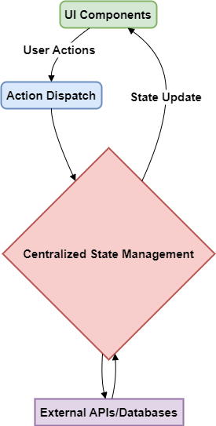
State management in web apps
How is State managed in web apps?
Local state management
Global state management
Redux

Slide 20
State management in web apps
Redux
Redux is a pattern and library for managing and updating application state.
Redux helps you manage "global" state - state that is needed across many parts of your application.
It serves as a centralized store for state that needs to be used across your entire application, with rules ensuring that the state can only be updated in a predictable fashion.
Redux is commonly used with React.
Read more on Redux here.

Slide 21
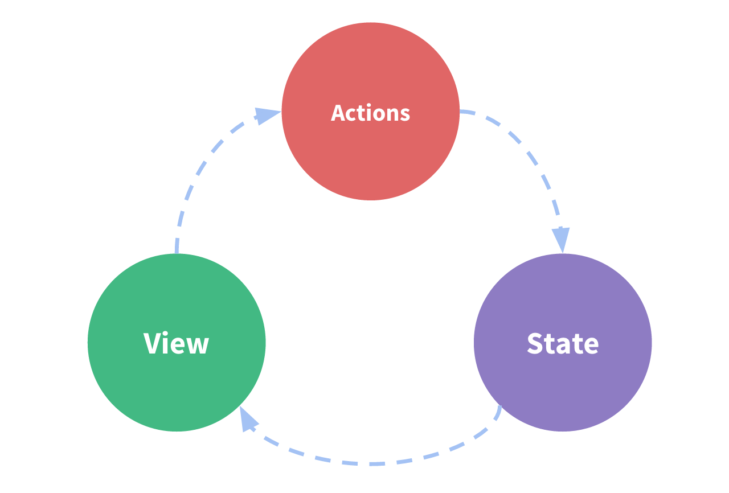
State management in web apps
Redux one-way data flow
Source: https://redux.js.org/tutorials/essentials/part-1-overview-concepts
Notes:
State describes the condition of the app at a specific point in time
The UI (View) is rendered based on that state
When something happens, the state is updated based on what occurred
The UI re-renders based on the new state
The simplicity can break down when we have multiple components that need to share and use the same state
One way to solve this is to extract the shared state from the components and put it into a centralized location outside the component tree.
Basic idea behind Redux: a single centralized place to contain the global state in your application, and specific patterns to follow when updating that state to make the code predictable.

Slide 22
State management in web apps
Redux is not always needed.
Do not use Redux until you have problems with vanilla React.
When to use Redux?
You have large amounts of application state that are needed in many places in the app.
The app state is updated frequently over time.
The logic to update that state may be complex.
The app has a medium or large-sized codebase and might be worked on by many people.

Slide 23
Props and State
Props: Props are used to pass data from a parent component to a child component.
State: State is used to manage data that changes over time in a component.

Slide 24
Event Handlers
In React, event handlers are functions that are called in response to user actions, such as clicks, keystrokes, or form submissions.
React event handlers are typically defined as methods of a component class or as arrow functions within a functional component.
In JSX, event handlers are specified as attributes of elements, using a naming convention where the event name is prefixed with on, followed by the name of the event in camelCase.
Event handlers can receive an event object as a parameter, which contains information about the event, such as the target element, the mouse position, or the key that was pressed.

Slide 25
Hooks
React Hooks are a way to use state and other React features in functional components, without the need for class components.
The most common Hooks are useState, useEffect, useContext, and useReducer. Each Hook has a specific purpose and usage.
The useState Hook allows you to add state to a functional component. It returns an array with two values: the current state value and a function to update the state.
The useEffect Hook allows you to perform side effects in a functional component, such as fetching data from an API or updating the DOM. It takes a function as its argument and runs it after every render.
The useContext Hook allows you to access data from a React context in a functional component. It takes a context object as its argument and returns the current context value.
The useReducer Hook is an alternative to useState that allows you to manage more complex state updates. It takes a reducer function and an initial state value as its arguments and returns the current state value and a dispatch function to update the state.
Hooks should only be used at the top level of a functional component or another custom Hook. They should not be used inside loops or conditionals.

Slide 26
Managing state | Reacting to inputs
As your application grows, it helps to be more intentional about how your state is organized and how the data flows between your components.
Redundant or duplicate state is a common source of bugs.
React uses a declarative way to manipulate the UI.
Instead of manipulating individual pieces of the UI directly, you describe the different states that your component can be in, and switch between them in response to the user input.
This is similar to how designers think about the UI.

Slide 27
Managing state | State Structure
Structuring state well can make a difference between a component that is pleasant to modify and debug, and one that is a constant source of bugs.
Group related state. If you always update two or more state variables at the same time, consider merging them into a single state variable.
Avoid contradictions in state. When the state is structured in a way that several pieces of state may contradict and “disagree” with each other, you leave room for mistakes. Try to avoid this.
Avoid redundant state. If you can calculate some information from the component’s props or its existing state variables during rendering, you should not put that information into that component’s state.
Avoid duplication in state. When the same data is duplicated between multiple state variables, or within nested objects, it is difficult to keep them in sync. Reduce duplication when you can.
Avoid deeply nested state. Deeply hierarchical state is not very convenient to update. When possible, prefer to structure state in a flat way.

Slide 28
Managing state | State Sharing
Sometimes, you want the state of two components to always change together.
Remove state from both and move it to the closest parent component
Then pass it down to them via props
This is known as lifting state up, and it’s one of the most common things you will do writing React code.

Slide 29
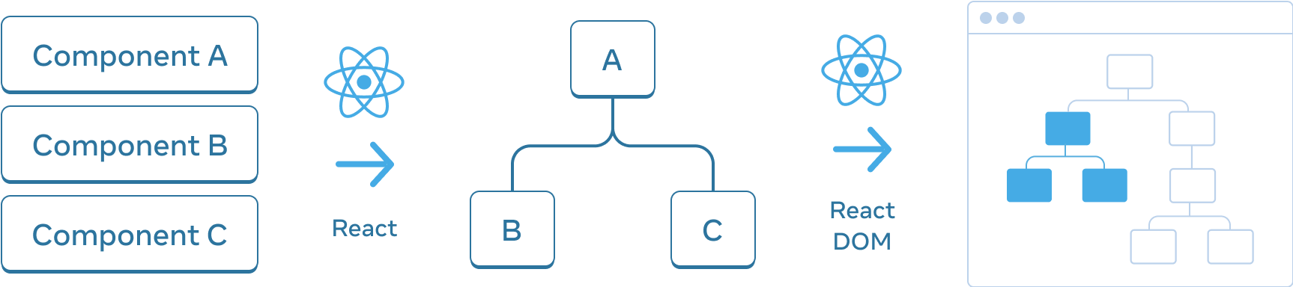
Managing state |Preserving & Resetting State
State is isolated between components.
React keeps track of which state belongs to which component based on their place in the UI tree.
You can control when to preserve state and when to reset it between re-renders.

Slide 30
Managing state | Using Reducer
Components with many state updates spread across many event handlers can get overwhelming
For these cases, you can consolidate all the state update logic outside your component in a single function, called a reducer.
Although reducers can “reduce” the amount of code inside your component, they are named after the reduce() operation that you can perform on arrays.

Slide 31
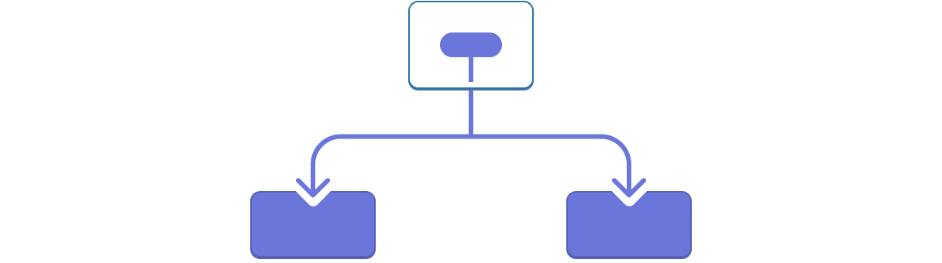
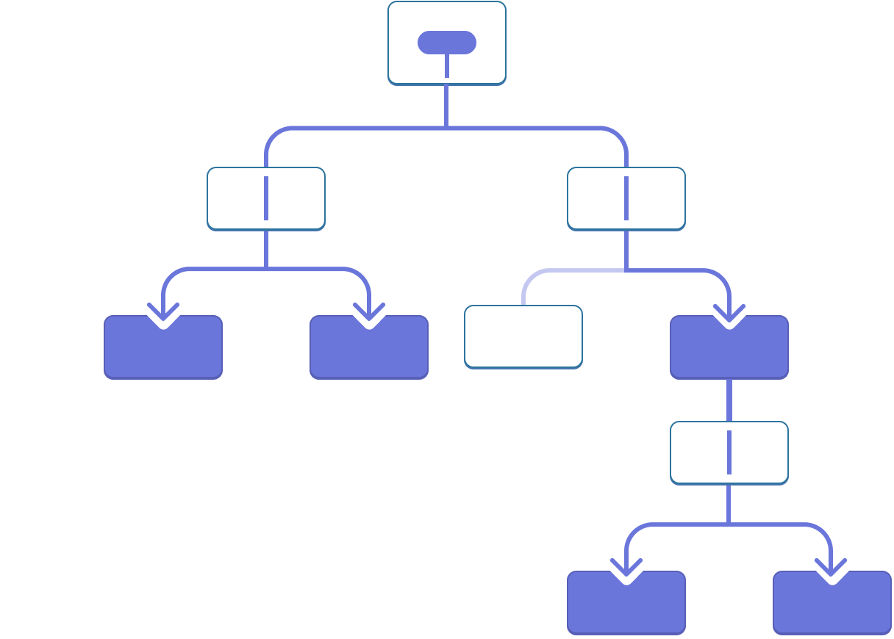
Managing state | with Context
Usually, you will pass information from a parent component to a child component via props.
But passing props can become verbose and inconvenient if you must pass them through many components in the middle, or if many components in your app need the same information.
Context lets the parent component make some information available to any component in the tree below it no matter how deep without passing it explicitly through props.

Slide 32

Bundling
In web development, bundling refers to combining multiple files into a single file.
Bundling is typically done with JavaScript or CSS files.
Bundling reduces the number of HTTP requests needed to fetch all the required resources for a web page.
This can improve the page's performance by reducing network latency.
Bundling tools like Webpack or Parcel are used to create the bundle file.
These tools analyze dependencies between files to create the bundle.
Optimization techniques like minification and tree shaking may also be used as part of the bundling process.

Slide 33
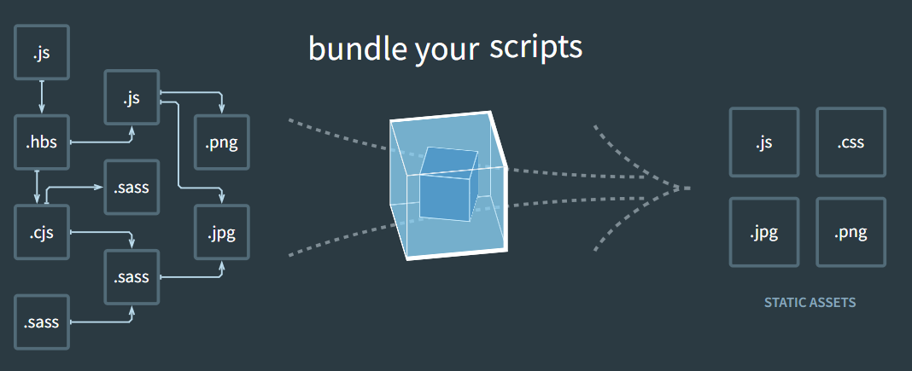
Webpack
Webpack is an open-source bundling tool and module bundler used in web development.
It is used to bundle JavaScript files and other assets like CSS, images, and fonts for web applications.
Webpack analyzes the dependencies between modules in the application and generates a single optimized bundle file.
It includes a built-in development server that allows developers to preview their applications in a browser and see live changes.
Webpack offers features like code splitting, lazy loading, tree shaking, and hot module replacement to optimize and speed up performance.
It is highly configurable and can be customized according to project requirements.
Webpack is widely used in modern web development frameworks like React, Vue, and Angular.
https://webpack.js.org/

Slide 34

Parcel
Parcel is an open-source web application bundler and build tool, similar to Webpack.
It is designed to be zero-config, meaning that it requires minimal setup and configuration to get started.
Parcel can bundle a variety of web assets, including JavaScript, CSS, HTML, images, and more.
It automatically handles file transformations, such as transpiling ES6 code to ES5 or compressing images.
Parcel can use multiple cores to build and bundle projects in parallel, which can reduce build times.
It includes a built-in development server that allows developers to see their changes in real-time as they make modifications to their code.
Parcel has gained popularity among developers due to its ease of use and simplicity.
It has been adopted by popular frameworks such as React, Vue, and Angular.
https://parceljs.org/

Slide 35
Setting Up React
Official Documentation recommend to use a framework for react
Frameworks provide features that most apps and sites eventually need, including routing, data fetching, and generating HTML.
Popular Frameworks
Next.js
Remix
Gatsby
Expo (for native apps)

Slide 36

Vite
Vite is a build tool and development server for modern web applications.
It was created by Evan You, the creator of Vue.js.
Vite is known for its fast startup time.
It uses a development server that leverages modern browser features like native ES modules and HTTP/2 to quickly serve application code.
Vite provides a build tool that includes features like code splitting and tree shaking to optimize the final application bundle for deployment.
Vite is primarily used for developing front-end applications built with frameworks like React or Vue.js.

Slide 37
Web Application security
OWASP, or the Open Web Application Security Project, is a nonprofit organization focused on software security.
OWASP Top 10 is a list of the 10 most common web application security risks.

Slide 38
Web Application security
OWASP Top 10 Vulnerabilities 2021
Broken Access Control
Cryptographic Failures
Injection
Insecure Design
Security Misconfiguration
Vulnerable and Outdated Components
Identification and Authentication Failures
Software and Data Integrity Failures
Security Logging and Monitoring Failures
Server-Side Request Forgery
Notes:
Broken Access Control: Flaws in access control can allow unauthorized users to access or modify data they shouldn't have access to, perform unauthorized functions, and more.
Cryptographic Failures: Previously known as "Sensitive Data Exposure", it focuses on failures related to cryptography which lead to sensitive data not being protected adequately.
Injection: Injection flaws, such as SQL, NoSQL, OS, and LDAP injection, occur when untrusted data is sent to an interpreter as part of a command or query. The attacker’s hostile data can trick the interpreter into executing unintended commands or accessing unauthorized data.
Insecure Design: This is a broad category that includes any vulnerability that arises from the absence of security controls or a design that does not account for security.
Security Misconfiguration: Security misconfiguration can happen at any level of an application stack, including network services, platforms, web servers, databases, applications, and more.
Vulnerable and Outdated Components: This risk refers to using components, such as libraries, frameworks, and other software modules, that are vulnerable or out of date, and could be exploited by attackers.
Identification and Authentication Failures: This risk covers shortcomings in authentication and session management functions that can allow attackers to compromise passwords, keys, or session tokens, or exploit other implementation flaws to assume other users’ identities.
Software and Data Integrity Failures: This category is concerned with making sure software and data have not been tampered with. Inadequate integrity checking can lead to unauthorized information being trusted and processed.
Security Logging and Monitoring Failures: Insufficient logging and monitoring can prevent or delay the detection of a security breach, potentially leading to damage or interruption of services.
Server-Side Request Forgery (SSRF): SSRF flaws occur when a web application fetches a remote resource without validating the user-supplied URL, allowing an attacker to make requests to internal services from the vulnerable server.

Slide 39
Web Application security
Testing an application for the OWASP vulnerabilities is a crucial step in application development.
[YouTube] What is The OWASP Top 10? | A Radware Minute
[Mandatory] Read OWASP Top Security Risks & Vulnerabilities 2021.

Slide 40
Web Application security
HTTP Security Headers
HTTP security headers are a subset of HTTP headers that is related specifically to security.
Setting suitable headers in your web applications and web server settings is an easy way to greatly improve the resilience of your web application against many common attacks.
Read this link on HTTP Security Headers.
Some additional information can be found here too.

Slide 41
Wrap up
See this link for a step-by-step guide on becoming a frontend developer.
Here’s a nice overview on Frontend development: [YouTube] Frontend web development - a complete overview

Slide 42
Summary
What is frontend development?
Why is frontend development important?
HTML, CSS, JS
Document Object Model (DOM)
State in Web apps
State Management
Web Application Security
OWASP Top 10 Security Risks & Vulnerabilities
HTTP Security Headers

Slide 43
References
What is the Document Object Model?
Introduction to the DOM
The Best React State Management Tools for Enterprise Applications
Redux Essentials, Part 1: Redux Overview and Concepts
OWASP Top 10 Vulnerabilities

Slide 44

Thank You
Vishan.j@sliit.lk
nelum.a@sliit.lk

